Slide 1


Category review: Chips
Retail Analytics
1
Classification: Confidential

Slide 2
Our 17 year history assures best practice in privacy, security and the ethical use of data
We all have a responsibility to use data for good
Privacy
Security
Ethical use of data
Applies to all facets of our work, from the initiatives we take on, the information we use and how our solutions impact individuals, organisations and society.
We have built our business based on privacy by design principles for the past 17 years
Quantium has strict protocols around the receipt and storage of personal information
All information is de-identified using an irreversible tokenisation process with no ability to
re-identify individuals.
We are ISO27001 certified - internationally recognised for our ability to uphold best practice standards across information security
We use ‘bank grade’ security
to store and process our data
Comply with 200+ security requirements from NAB, Woolworths and other data partners
All partner data is held in separate restricted environments
All access to partner data is limited to essential staff only
Security environment and processes regularly audited by our data partners.
Quantium believes in using data for progress, with great
care and responsibility.
As such please respect the commercial in confidence nature
of this document.
2
Classification: Confidential

Slide 3
Executive summary
01
Chips Category Review
The sales have climbed up until the day before Christmas, which is a good opportunity to capitalise on this momentum with special offers to boost the purchases. However, the sales also decreased after Christmas.
Mainstream young singles/couples contribute most to the sales.
Older families and young families, who make up our target market for sales,
purchase more chips overall for all three Life stages.
02
Trial Store Analysis
To replicate the previous performance of the chosen trial stores 77,86 and 88,
control stores 233, 155 and 237 were created.
Following the implementation of the new shop design, the trial store's
effectiveness and the control store were contrasted.
During the trial period, the trial in stores 77 and 86 differed considerably from
the control store in terms of both sales and customer count.
However, as compared to its control shop, the increase for trial store 88 was not that substantial.

Slide 4
Category
01

Slide 5
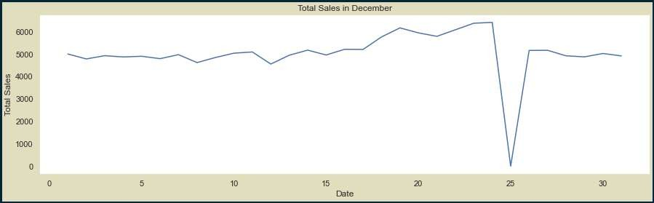
As Christmas approaches, sales gradually grow. On New Year's Eve, they resume their early December levels. However, because stores were closed for Christmas, there were no sales on December 25 as indicated by the dip.
The dip indicates the zero transactions due to the holiday store closures.

Slide 6
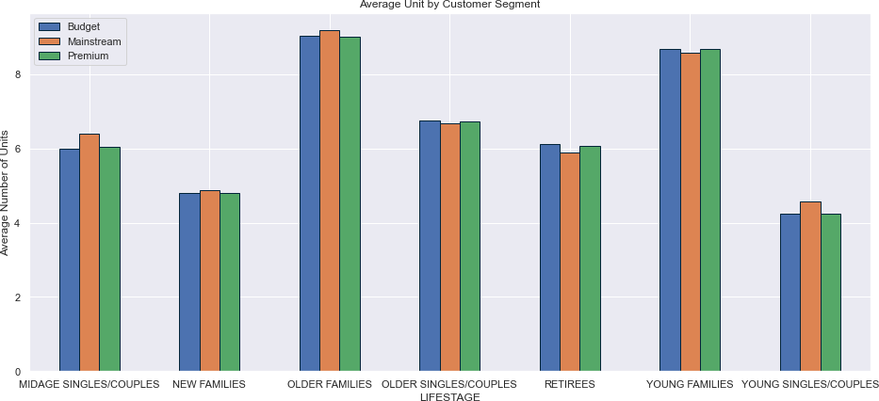
Each individual life stage profile shows a constant level of affluence; older & younger families are the buyers that make the largest average transactional purchases.

Slide 7
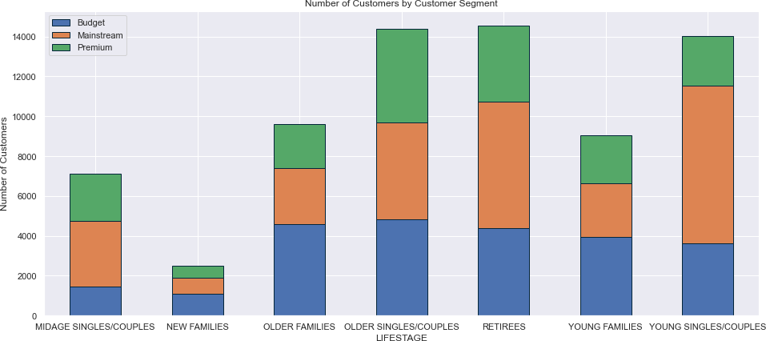
The majority of mainstream young singles and couples purchase snacking chips, while mainstream retirees also make up a sizeable component of this market.

Slide 8
02
Trial store performance

Slide 9
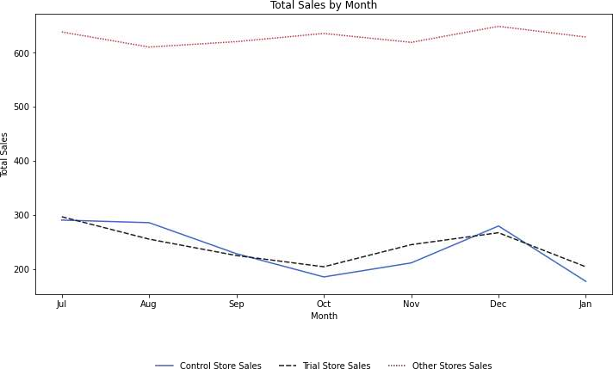
The trial store's performance in terms of total sales and customer count are reflected in the Control stores, whereas it is not exhibited in the other stores.

Slide 10
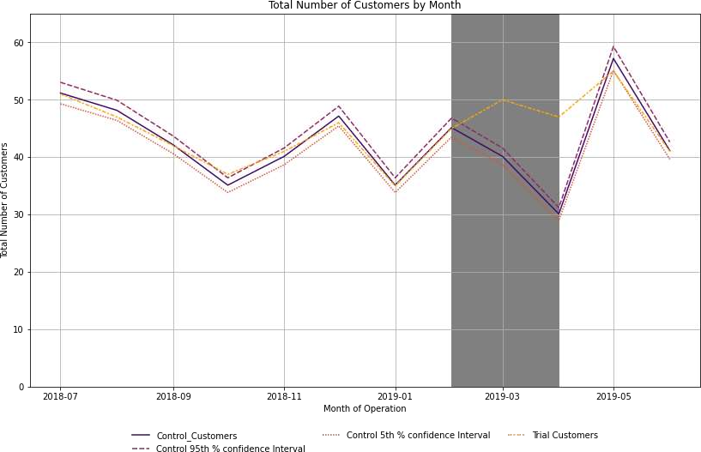
Trial shops 77 and 86 significantly outperformed Control stores 233 and 155 in terms of both total sales and the number of customers they attracted throughout the trial period. The performance improvement at the 88th trial shop, however, is modest.
Trial Period

Slide 11
Disclaimer: This document comprises, and is the subject of intellectual property (including copyright) and confidentiality rights of one or multiple owners, including The Quantium Group Pty Limited and its affiliates (Quantium) and where applicable, its third-party data owners (Data Providers), together (IP Owners). The information contained in this document may have been prepared using raw data owned by the Data Providers. The Data Providers have not been involved in the analysis of the raw data, the preparation of, or the information contained in the document. The IP Owners do not make any representation (express or implied), nor give any guarantee or warranty in relation to the accuracy, completeness or appropriateness of the raw data, nor the analysis contained in this document. None of the IP Owners will have any liability for any use or disclosure by the recipient of any information contained in, or derived from this document. To the maximum extent permitted by law, the IP Owners expressly disclaim, take no responsibility for and have no liability for the preparation, contents, accuracy or completeness of this document, nor the analysis on which it is based. This document is provided in confidence, may only be used for the purpose provided, and may not be copied, reproduced, distributed, disclosed or made available to a third party in any way except strictly in accordance with the applicable
11
written terms and conditions between you and Quantium, or otherwise with Quantium’s prior written permission

